Slide 1

Notes:
Slide 1: Use a greeting that will be familiar to your school community. We will be learning a new greeting later today, to use next week.

Slide 2
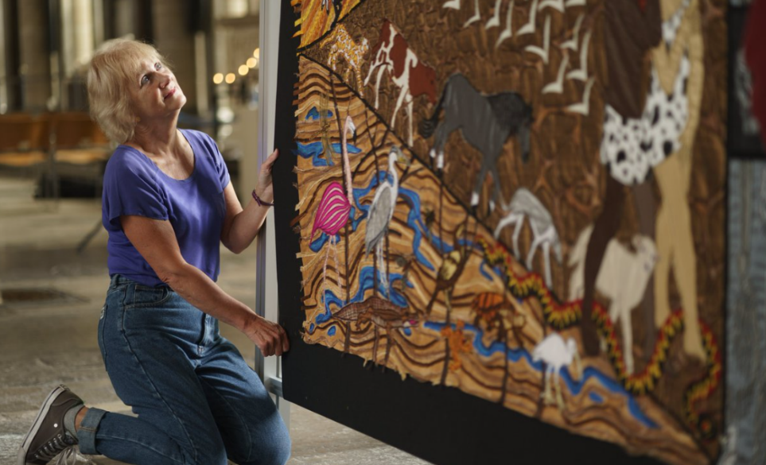
Creativity
Notes:
Slide 2: Creativity
This term, we are beginning a very special series based on the work of artist Jacqui Parkinson – and a very special exhibition that is coming to Guildford Cathedral in just a few weeks. This is her with one of her creations – a very big picture made out of fabric and stitches. I wonder which story you think she’s made here?!
We’ll come back to her work later during our time together, but first, let’s think about what we mean by this word ‘Creativity’.

Slide 3
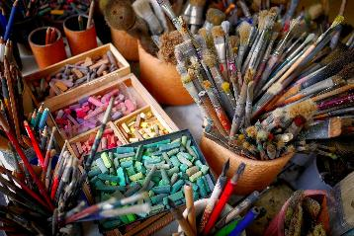
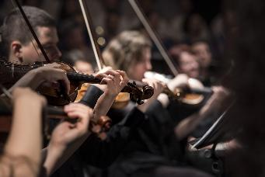
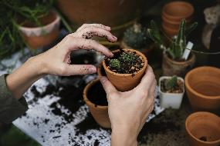
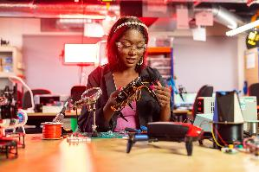
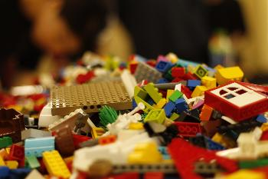
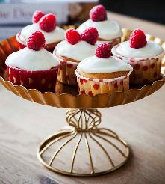
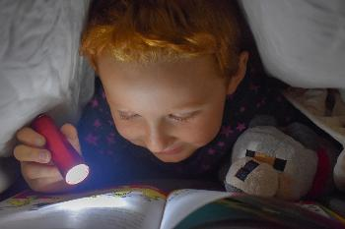
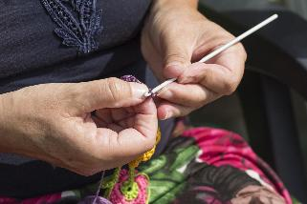
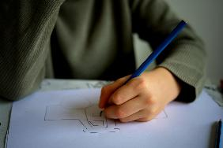
Creativity
Notes:
Slide 3: Creativity
Creativity is basically the ability to create something – to make something.
There are many different ways in which our creativity can be expressed. You can see some examples here… [briefly go through them]
When we make something out of paint, or Lego, or technology, or our imagination, for example, we are using our creativity. You might want to talk to each other in your classes this week about this big word!

Slide 4
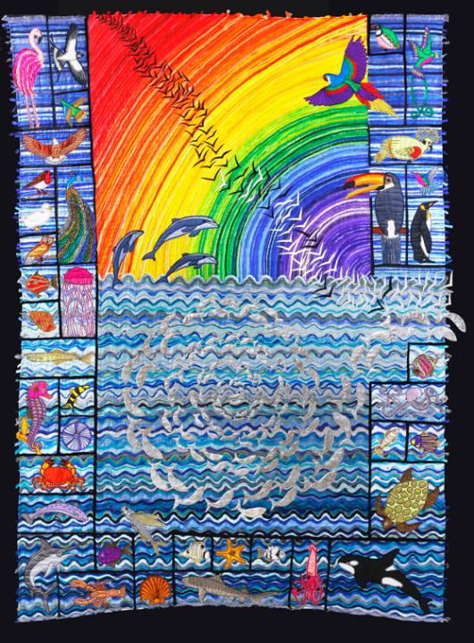
And God made…
Notes:
Slide 4: This is one of artist Jacqui Parkinson’s creations, featuring a story from the very beginning of the Bible, the holy book for Christians, which tells them how the world might have begun. It’s a story that Christian, Jewish and Muslim people share…. There are also LOTS of other, different ideas about this, but we’ll have to save those for a day when we have a bit more time!!
This story is one that has inspired Jacqui, so during our retelling of it, we will see her work from time to time!
There are some places where you can join in with your own ideas as part of this retelling, so be ready. There will be some pictures on the screen to help you. When I leave a space, that means I need some ideas from you, so listen hard and you’ll soon get the idea [you may need to help them initially]

Slide 5

Notes:
Slide 5: In the beginning, before the dawn of time, God was there. God said "I'll make a world" and he began.

Slide 6

That’s good!!
Notes:
Slide 6: God said "Let there be light" and there it was, a brilliant light that shone brightly in the heavens. The times when the light shone he named ..... DAY, and when it was dark, he called it ....... NIGHT. And God said "That's good!"

Slide 7
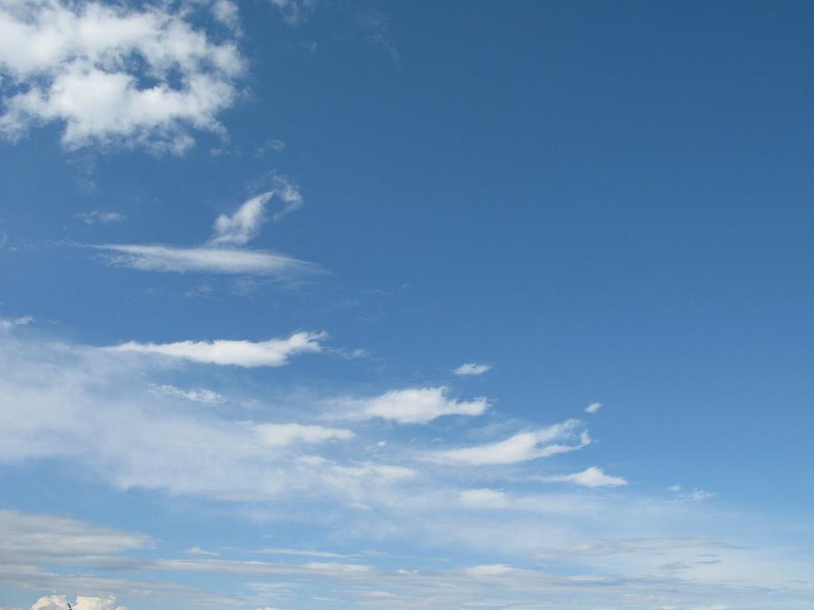
That’s good!!
Notes:
Slide 7: Then God said "Let there be sky" and there it was - a beautiful blue expanse of sky that stretched as far as the eye could see. And God said "That's good!"

Slide 8
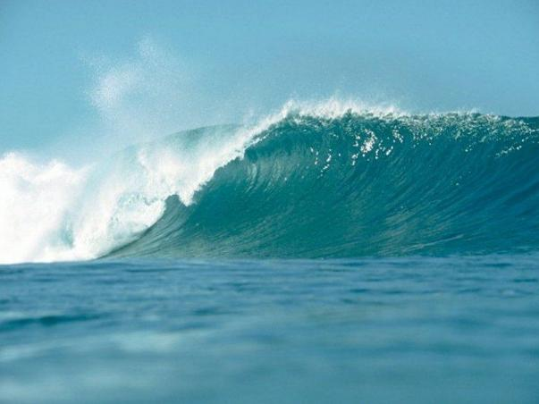
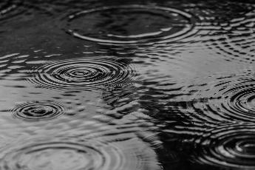
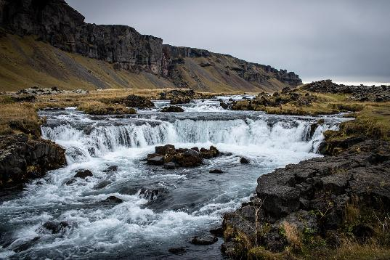
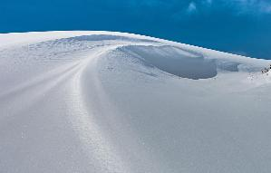
Notes:
Slide 8: Next God said "Let there be water", and water appeared - water of all different shapes and sizes ...............

Slide 9
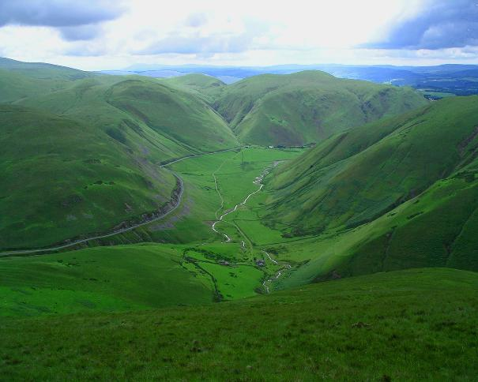
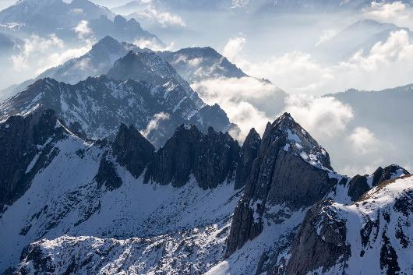
That’s good!!
Notes:
Slide 9: The places where there was no water, God named ...... LAND – land of all different heights and types………….… And God said "That's good!"

Slide 10
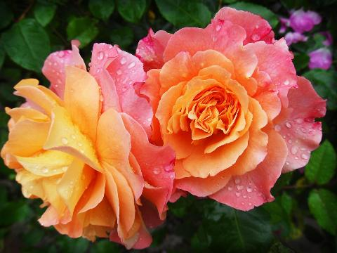
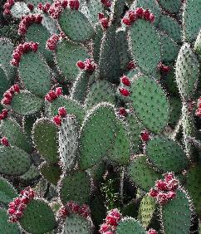
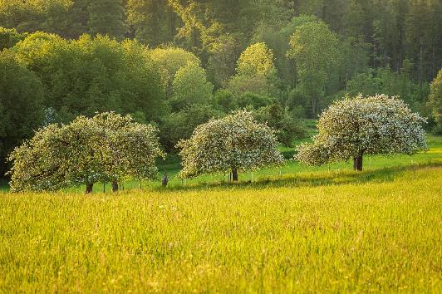
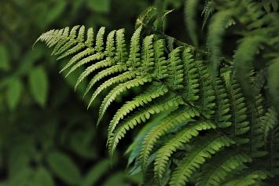
That’s good!!
Notes:
Slide 10: Then God said "Let there be plants" and all over the land, they began to grow................ And God said "That's good!"

Slide 11
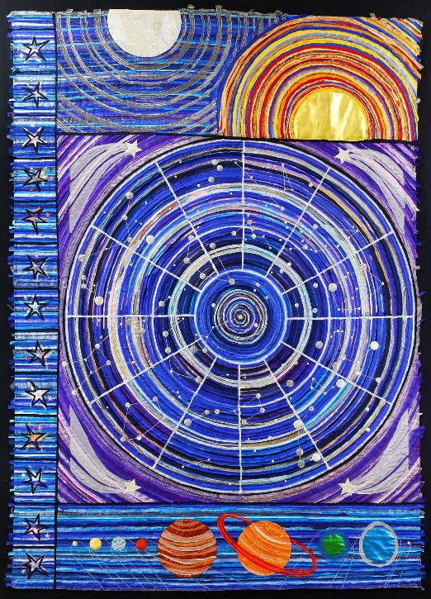
That’s good!!
Notes:
Slide 11: After all that, God said "Let there be lights in the sky for the night and the day." The day-time light God named..... SUN, and the night-time lights he named ..... MOON & STARS. And God said "That's good!"

Slide 12
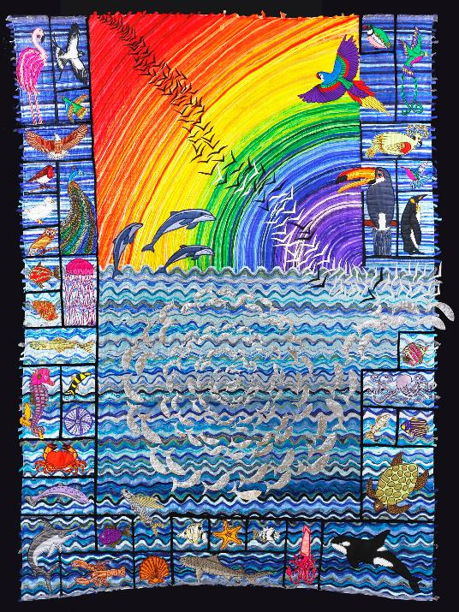
That’s good!!
Notes:
Slide 12: Then God said, "Let's have some fun ! Let there be creatures to live in the waters of the earth" and it was so. There were.......... And then God said "Let there be all sorts of creatures to fill the air" and the air was filled with the sound of beating wings, large and small. There were........... And God said "That's good!"

Slide 13
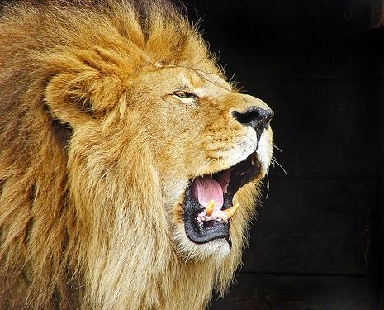
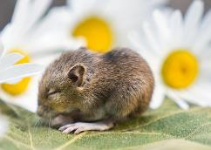
That’s good!!
Notes:
Slide 13: Then God said "Let there be animals of every shape and size to fill the earth" and there they were.............. And God said "That's good!"

Slide 14
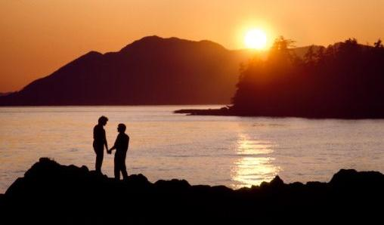
That’s good!!
Notes:
Slide 14: And last of all, God said "Let there be people, created to be creative, to look after all I have made." When he saw them, God said "That's good!"

Slide 15
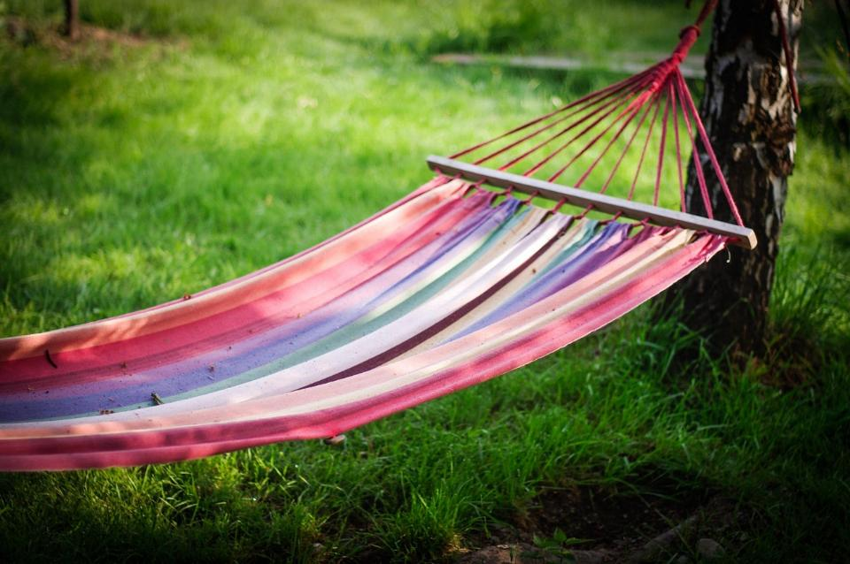
That’s good!!
Notes:
Slide 15: Then God said "Now let there be rest !" and there was - for a whole day ! And God said "That's good!"

Slide 16
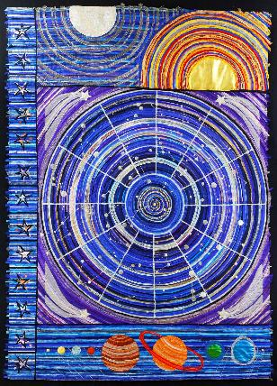

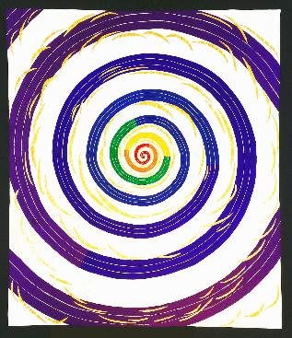
‘Let us make human beings in our image and likeness.’
…created to be creative…
Notes:
Slide 16: In her textile panels, Jacqui uses the image of a spiral to represent God, who is eternal – like a spiral that could carry on spiralling forever! You can also see it on every panel where God is a part of the story….We’ll see this a lot more during this term.
Earlier, in our story from the Bible of how ‘God made’, I wonder if you can remember the final thing that ‘God made’?....
It was human beings…..us! This story can be found in Genesis chapter 1, and we’re going to use some words that God spoke from verse 26, which will help us as we think some more about being creative. This is what God said when he made us: ‘Let us make human beings in our image and likeness.’
Christians believe that God made us to be like him – as we said in the story, we are …created to be creative…

Slide 17
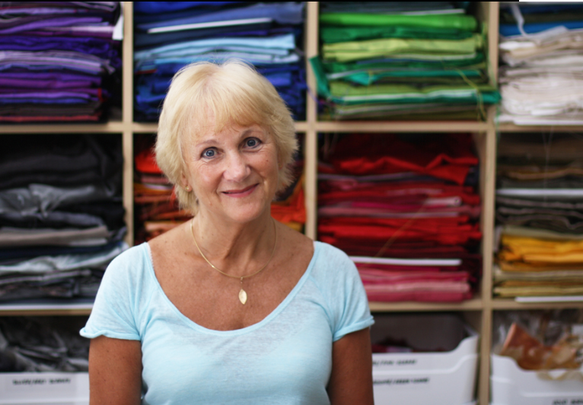
If we’re made in the image of God, then we were made to be creators.
Notes:
Slide 17: Jacqui herself talks about this too. She says ’If we’re made in the image of God, then we were made to be creators.’
I wonder what you think about this idea? [with older pupils, you might want to allow them time to talk to a partner]

Slide 18



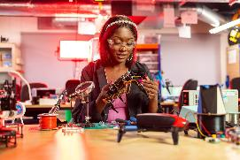

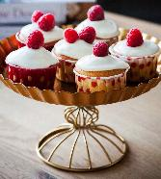
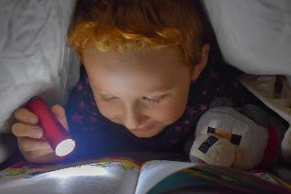
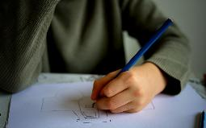
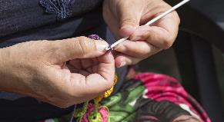
Creativity
….I wonder how you like to be creative?....or where you think your creativity comes from?....
….I wonder if being creative helps some people to feel closer to God?....
….I wonder how our creativity might help to inspire others?....
Notes:
Slide 18: Responding and words for worship
Today we’ve been thinking about creativity – in its many different forms. Let’s take some time now to be quiet and still, and think together. You might like to close your eyes to help you to think…..
….I wonder how you like to be creative?....or where you think your creativity comes from?....
….I wonder if being creative helps some people to feel closer to God?....
….I wonder how our creativity might help to inspire others?....
Opportunity for reflection / prayer
I’m going to pray now. If this is something that you feel comfortable doing, then find a way to make the words your own. If you don’t want to pray, then use the quiet to be still with your own thoughts.

Slide 19

Creator God
Thank you for the beautiful world that you created for us to be a part of. Thank you that you made us each to be creative, in the way that we can make and imagine in so many different ways. Help us to use our creativity to be a blessing to others, we pray.
Notes:
Slide 19: Prayer
Creator God
Thank you for the beautiful world that you created for us to be a part of. Thank you that you made us each to be creative, in the way that we can make and imagine in so many different ways. Help us to use our creativity to be a blessing to others, we pray.

Slide 20
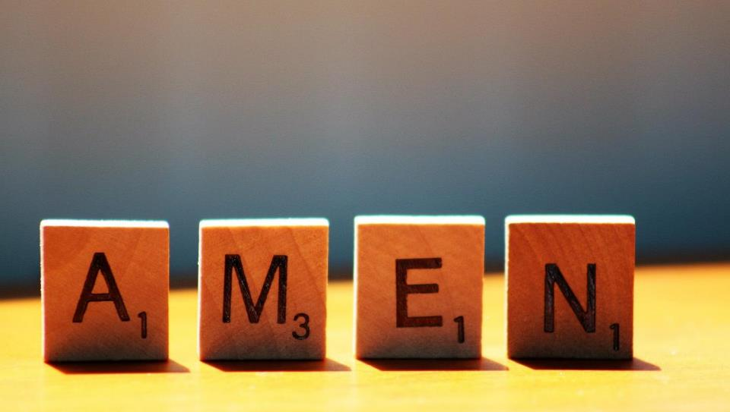

Slide 21

Leader: We are a creative community. As we gather together today…
ALL: May our thinking, talking and wondering help us to grow.
Notes:
Slide 21: Teach this new greeting, ready for next week.
This term, we will be using some of artist Jacqui’s work to help us to think during our times together – maybe her work might inspire us to be even more creative! And so, we are going to reflect this in our new greeting, which we will use every week. [teach BSL signs as well, if using]
Leader: We are a creative community. As we gather together today….
ALL: May our thinking, talking and wondering help us to grow.
Here are BSL actions for some of the words:
Leader’s words:
Creative: https://www.signdictionary.co.uk/view/creative?q=creative#title
Community: (we use the word ‘gathering’ as it’s a simpler sign!) https://www.signbsl.com/sign/gathering
Gather together: https://www.signbsl.com/sign/gather (1st video)
Response:
Think: https://www.brightbsl.co.uk/signs/think
Talk: https://www.signbsl.com/sign/talk (1st video)
Wonder: https://www.signbsl.com/sign/wonder (1st video)
Grow: https://www.signbsl.com/sign/grow (2nd video)

Slide 22
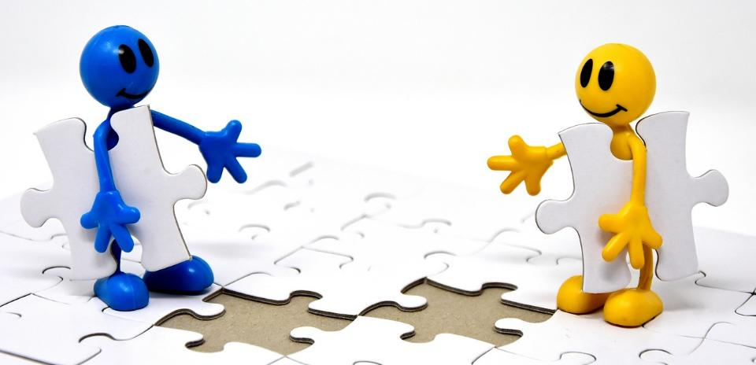


Leader: As we leave this place & time and go into the day ahead…
All: Together, we create a creative community!
Notes:
Sending: Slide 22
Leader: As we leave this place & time and go into the day ahead…
All: Together, we create a creative community!
BSL Together: https://www.signbsl.com/sign/together (1st video); Create: https://www.signbsl.com/sign/create (2nd video) You already have signs for ‘creative’ and ‘community’

Slide 23









Notes:
Slide 23: Reflective areas
Think: What does it mean for you to be ‘creative’? What do you like to ‘create’?
Talk: Talk together with others about your ideas – do you all have the same?
Why do you think this is?!
Do: Take a spiral template. You could…
• create your own pattern or picture
• write inside the spiral ways in which you are creative
• add some musical notes to create a tune
• display your ‘creations’ together

